Slide 1
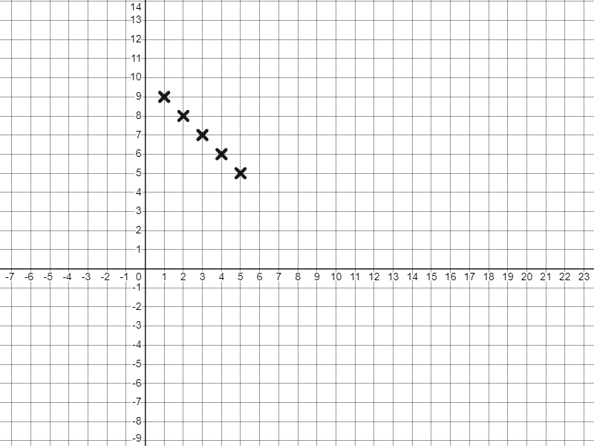
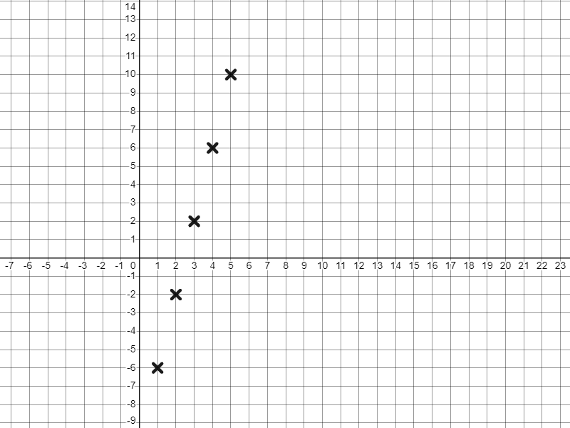
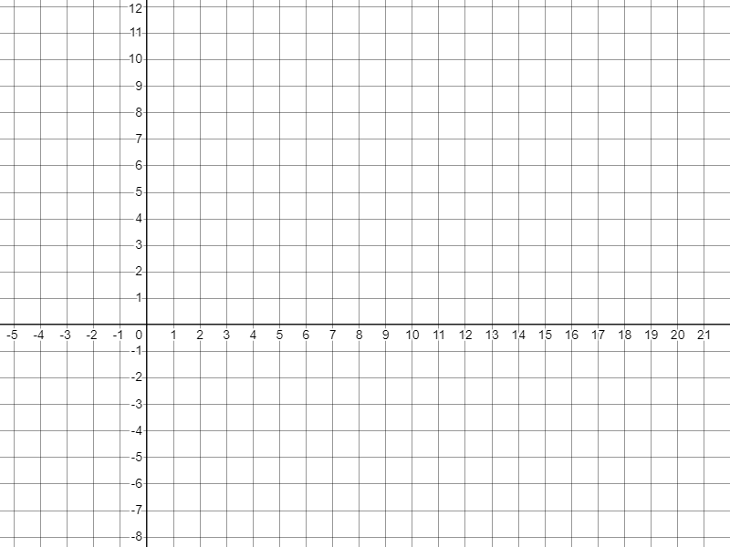
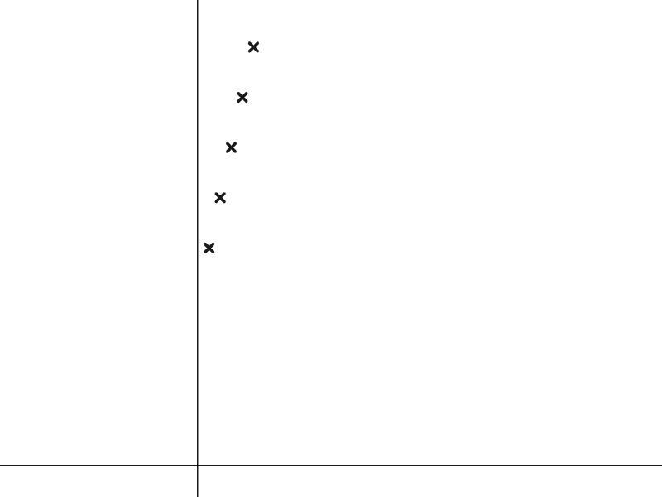
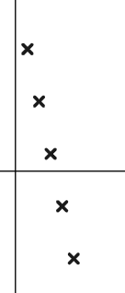
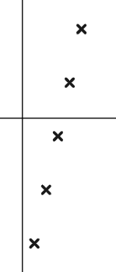
Checking and securing understanding of plotting coordinates generated from a rule
Task A: Plotting arithmetic sequences
1) Find and plot the first five terms of these arithmetic sequences.
a)
4n − 10
b)
10 − n
Term number (n) | 1 | 2 | 3 | 4 | 5
Term value (T) | −6 | −2 | 2 | 6 | 10
Term number (n) | 1 | 2 | 3 | 4 | 5
Term value (T) | 9 | 8 | 7 | 6 | 5
T
T
n
n
2) Match the sequences to their graph.
T
3n + 10
T
10 − 3n
T
3n − 10
Decreasing sequence, starting with positive terms.
Increasing sequence, all positive terms.
n
n
Increasing sequence, starting with negative terms.
n

Slide 2
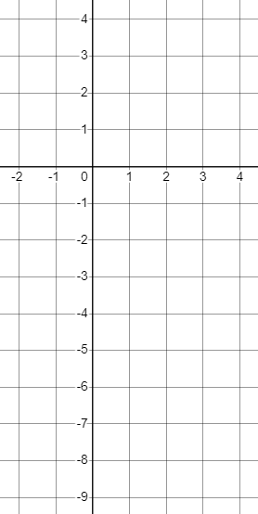
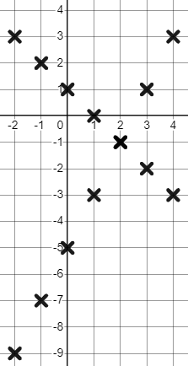
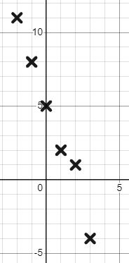
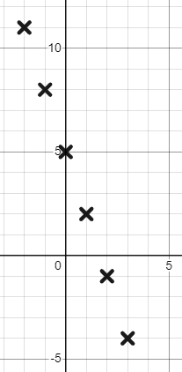
Checking and securing understanding of plotting coordinates generated from a rule
Task B: Plotting coordinates that follow a rule
1) Match the verbal rule to the simplified algebraic rule
y = x + 3
The x-coordinate multiplied by 5 subtracted from 3
y = 3x + 5
Add 3 to the x-coordinate
y = 5x − 3
The x-coordinate multiplied by 5 add 3
y = 5x + 3
The x-coordinate subtracted from 3
y = 3 − 5x
The x-coordinate multiplied by 5 subtract 3
y = 3 − x
The x-coordinate multiplied by 3 add 5
y
2) Complete the table of values and plot the rules:
a) y = 2x − 5
x | −2 | −1 | 0 | 1 | 2 | 3 | 4
y | −9 | −7 | −5 | −3 | −1 | 1 | 3
x
b) y = 1 − x
x | −2 | −1 | 0 | 1 | 2 | 3 | 4
y | 3 | 2 | 1 | 0 | −1 | −2 | −3
3) Jacob plots the rule y = 5 − 3x
Mark his work and give him feedback.
y
y
x | −2 | −1 | 0 | 1 | 2 | 3
y | 11 | 8 | 5 | 2 | 1 | −4
y = 5 − 3x is a linear rule, this should make a straight line.
This coordinate (2, 1) does not fit the rule. 5 − 3(2) = −1, plot (2, −1) instead.
x
x
Also, continue your lines to the edge of your grid.
Mathematics in Education and Industry
v2.2

